Slide 2


Slide 3
Modelling of Power Consumption
Model Validation
Model Combination

Slide 4
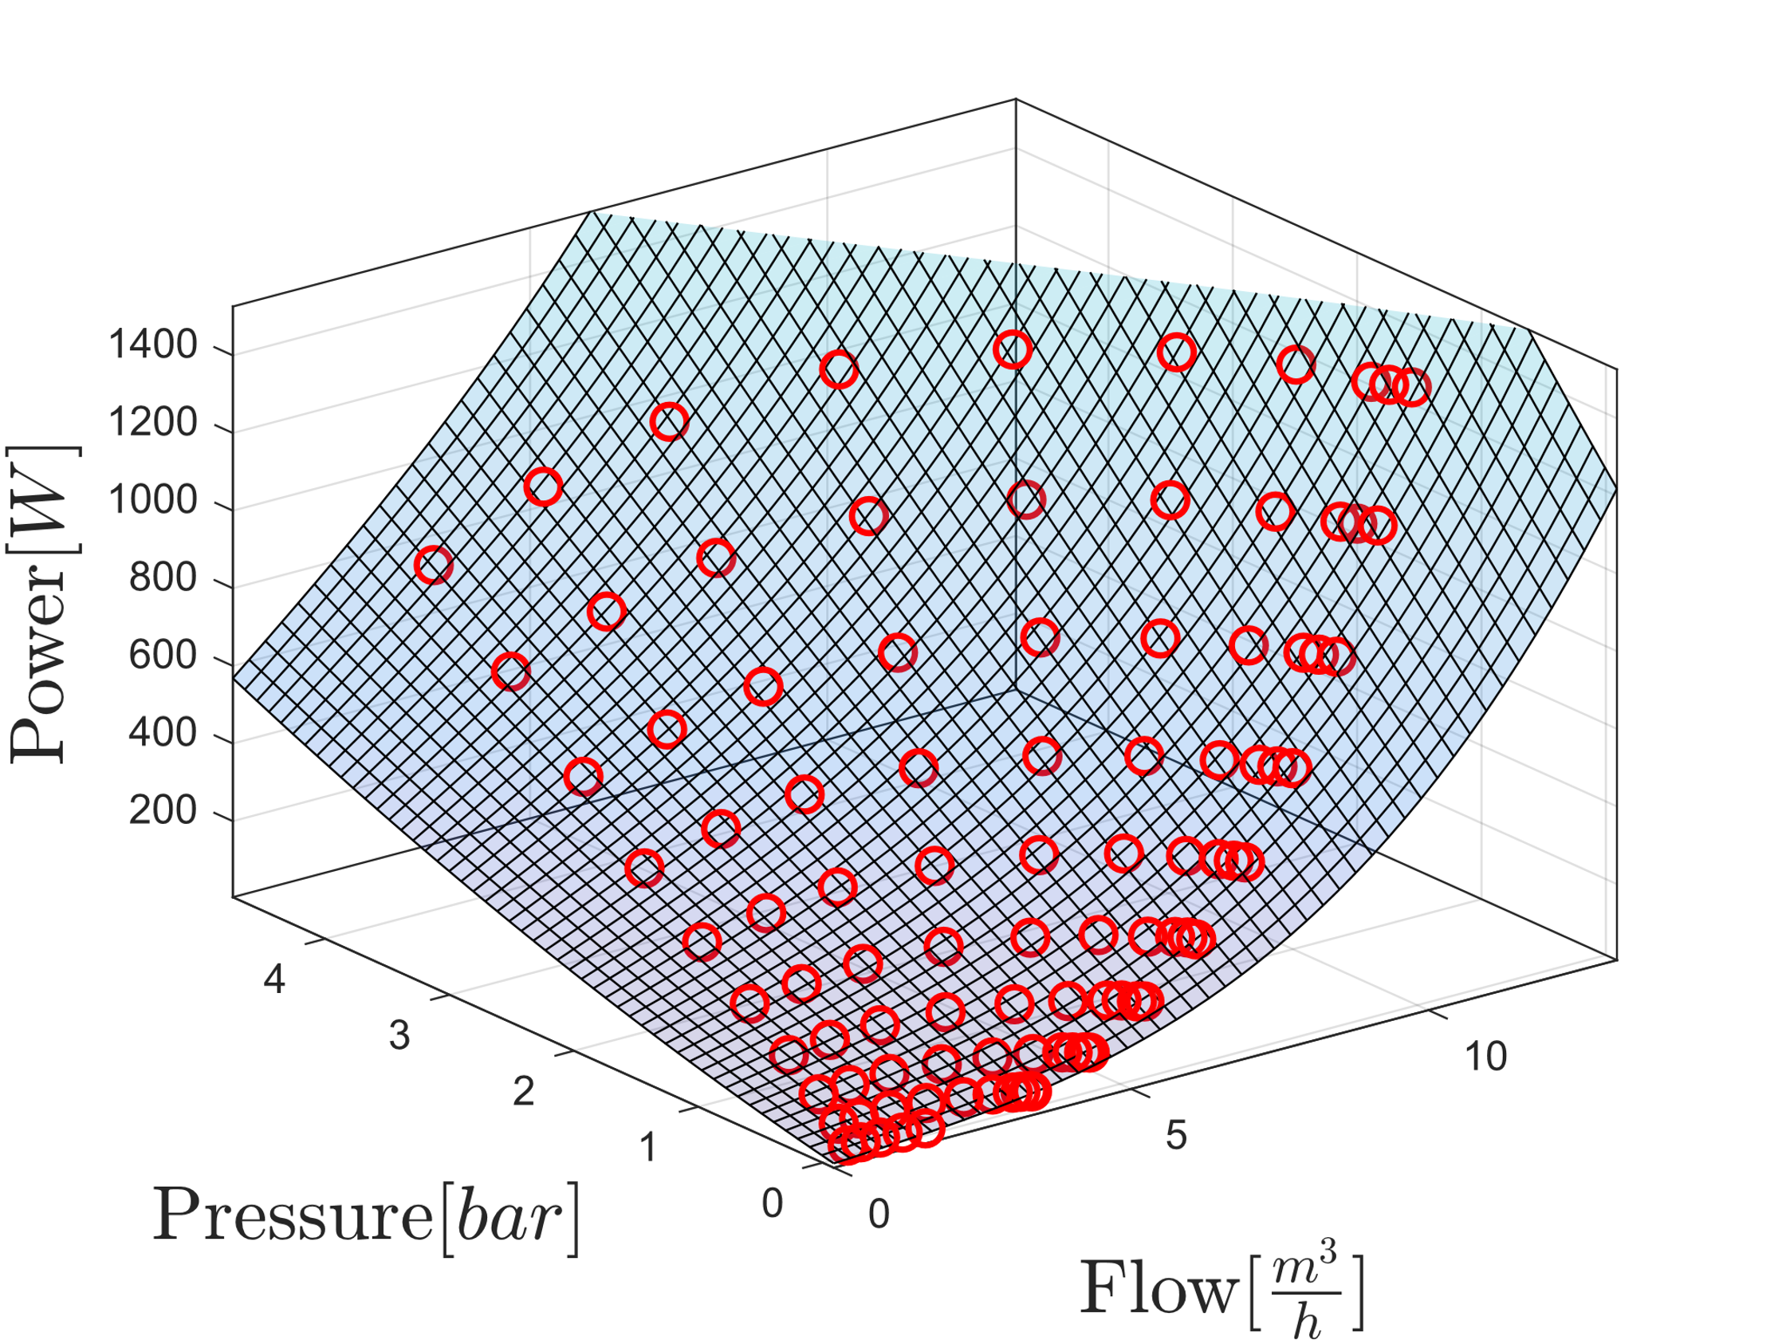
Power consumption
Model for single pump with collected data points in red

Slide 5
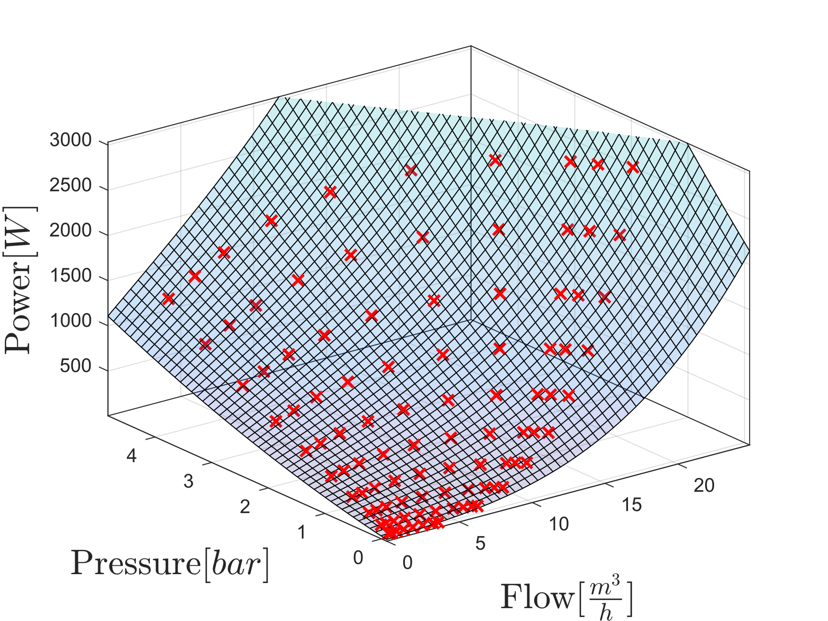
Power consumption
Model for two pumps with collected data points in red

Slide 6
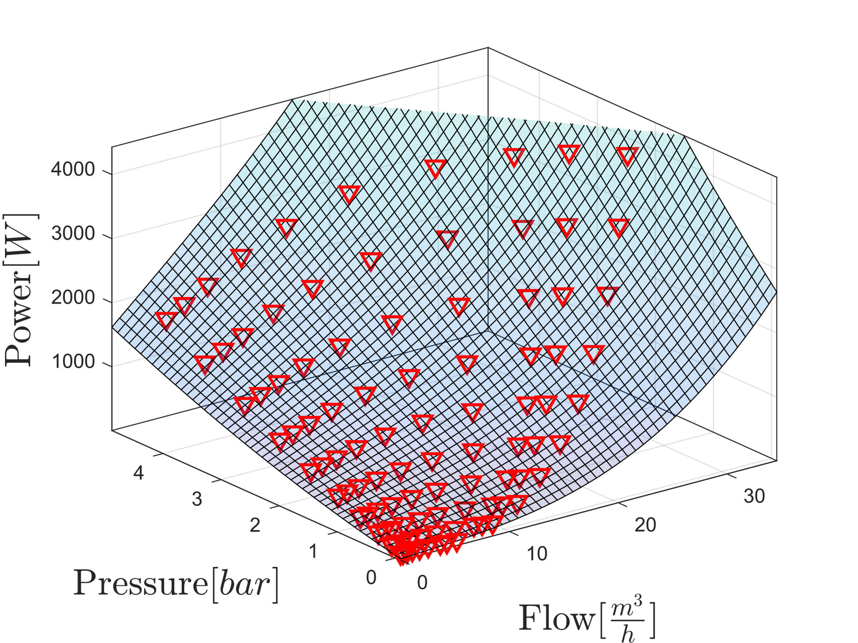
Power consumption
Model for three pumps with collected data points in red

Slide 7
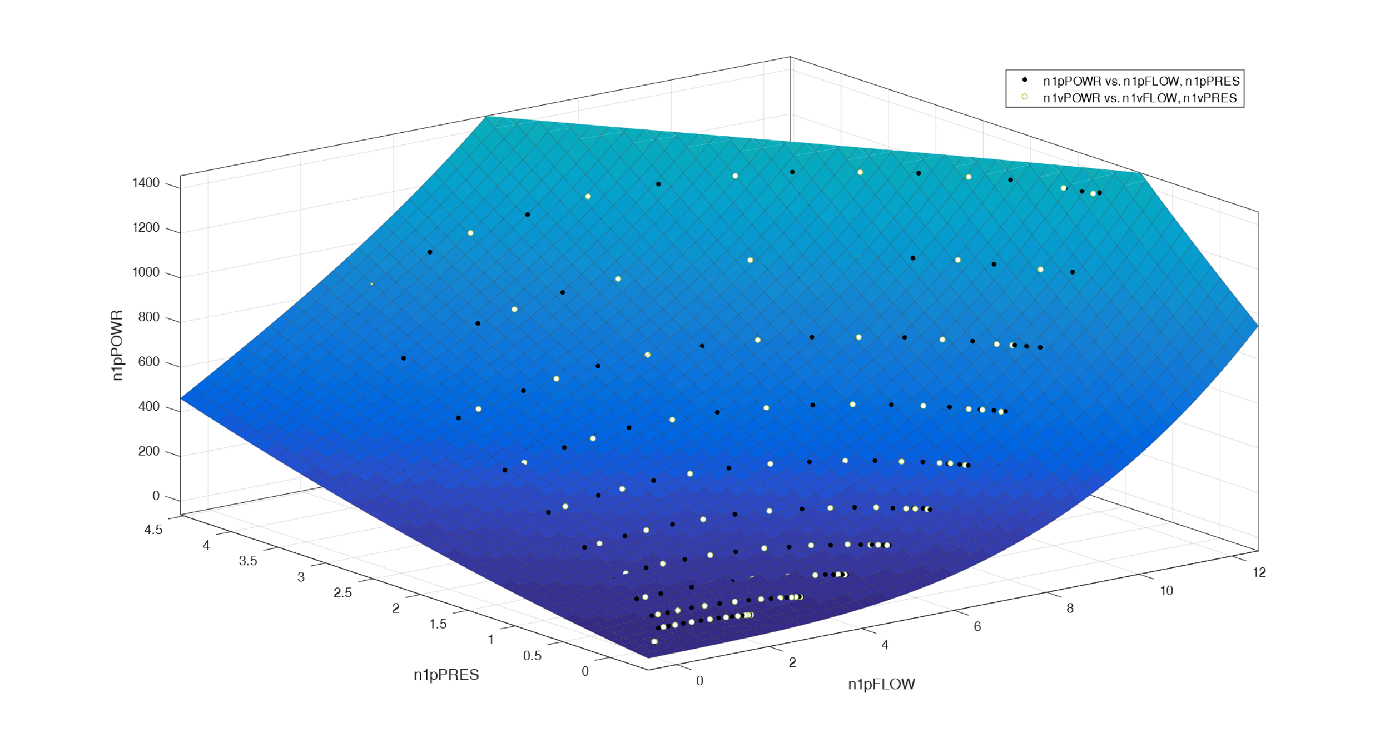
Model Validation
Validation for single-pump-model with validation data in white

Slide 8
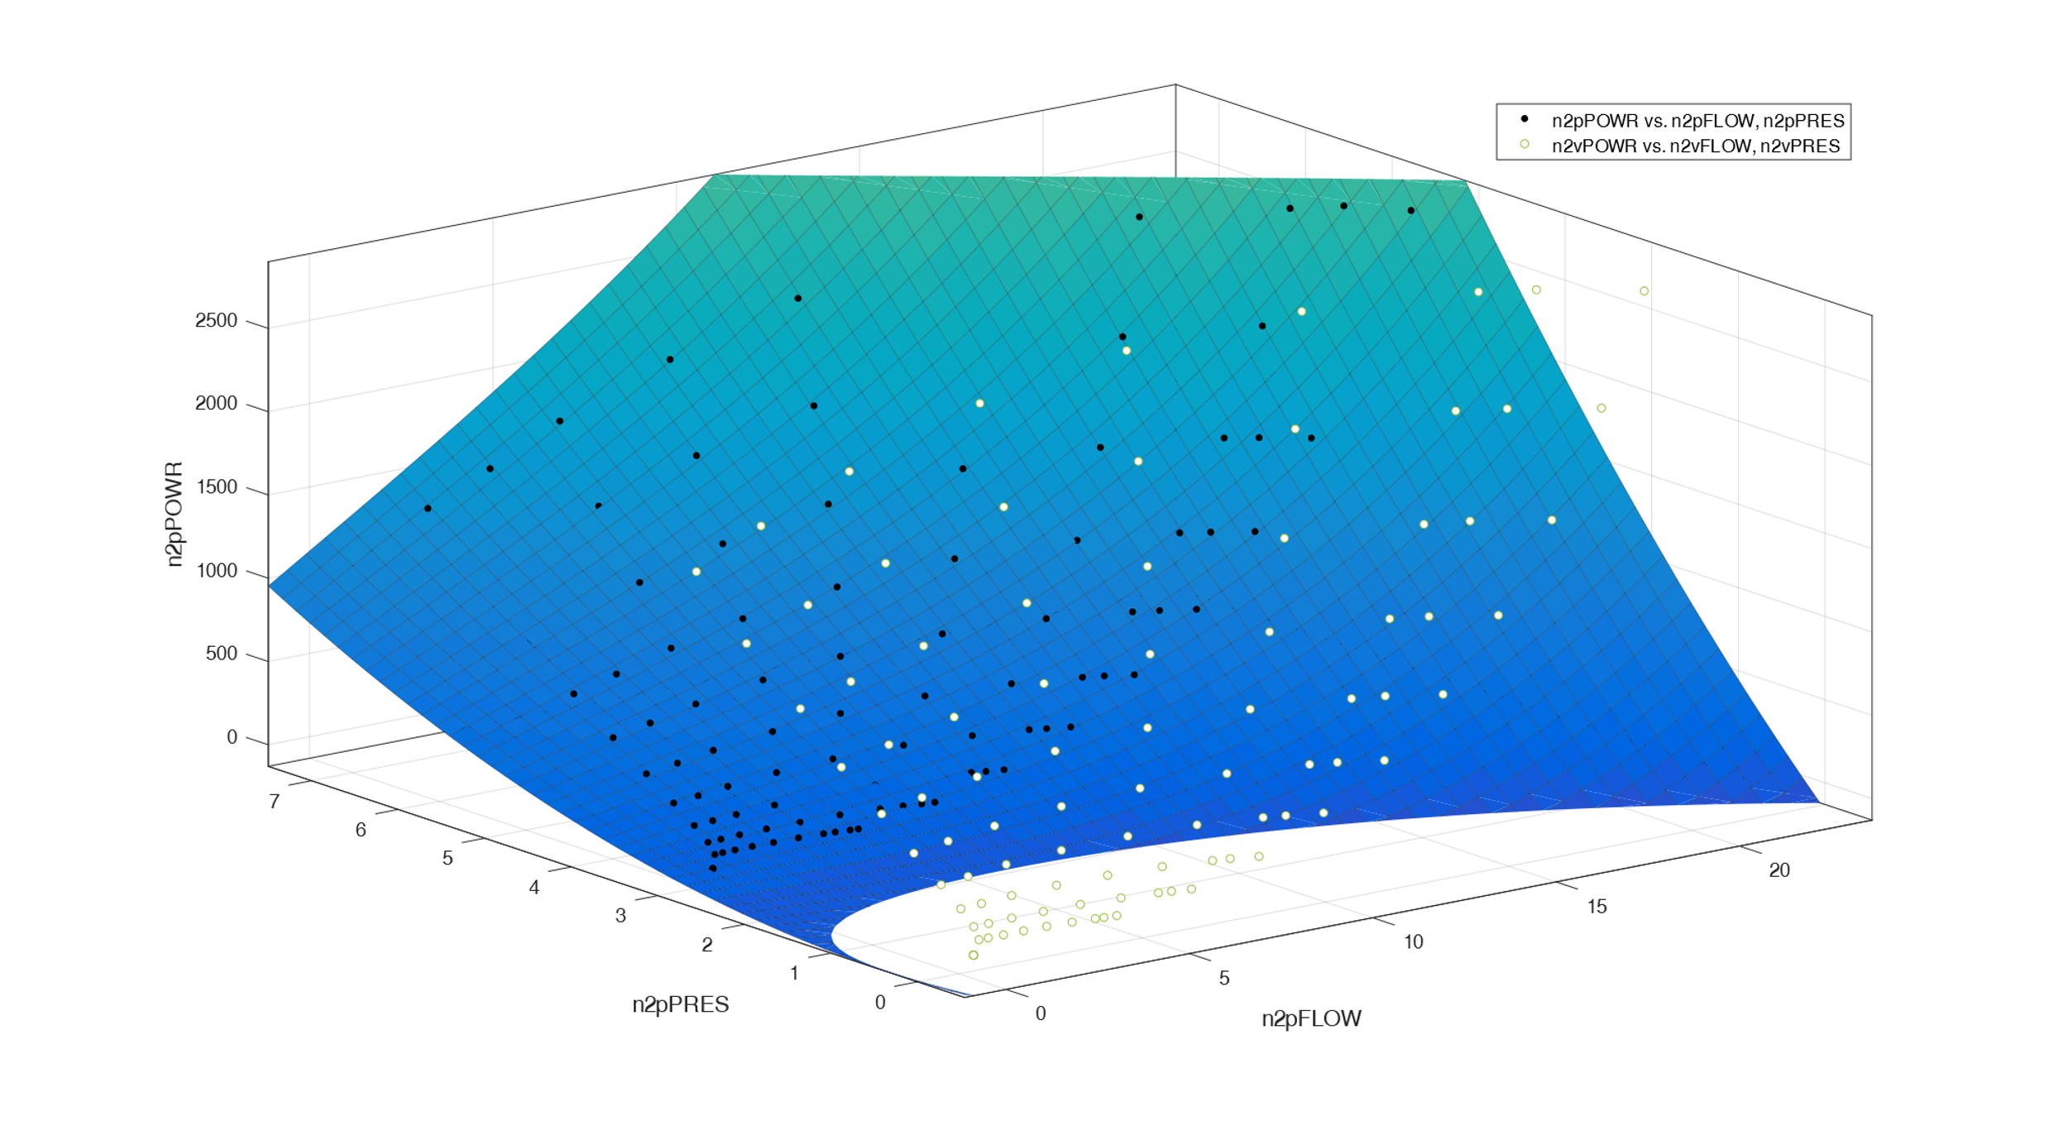
Model Validation
Validation for two-pump-model with validation data in white and pressure offset

Slide 9
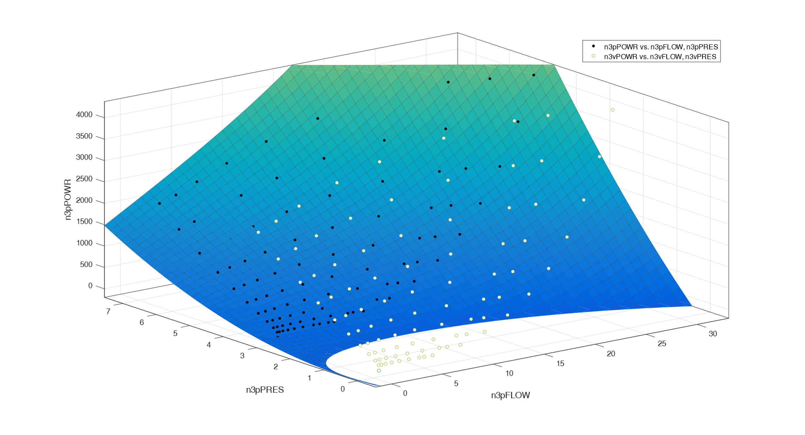
Model Validation
Validation for three-pump-model with validation data in white and pressure offset

Slide 10
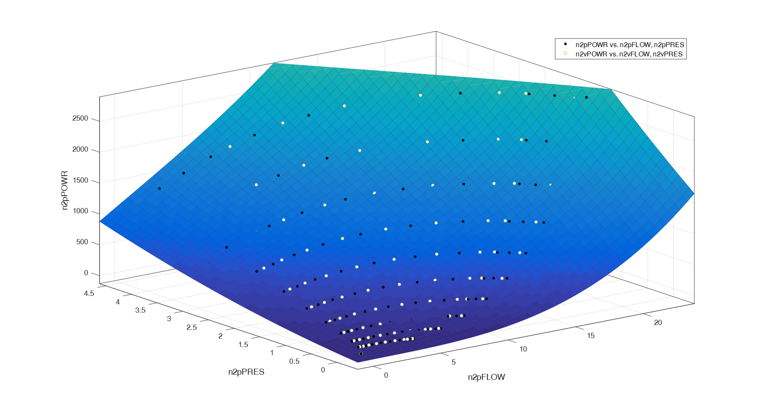
Model Validation
Validation for two-pump-model with validation data in white

Slide 11
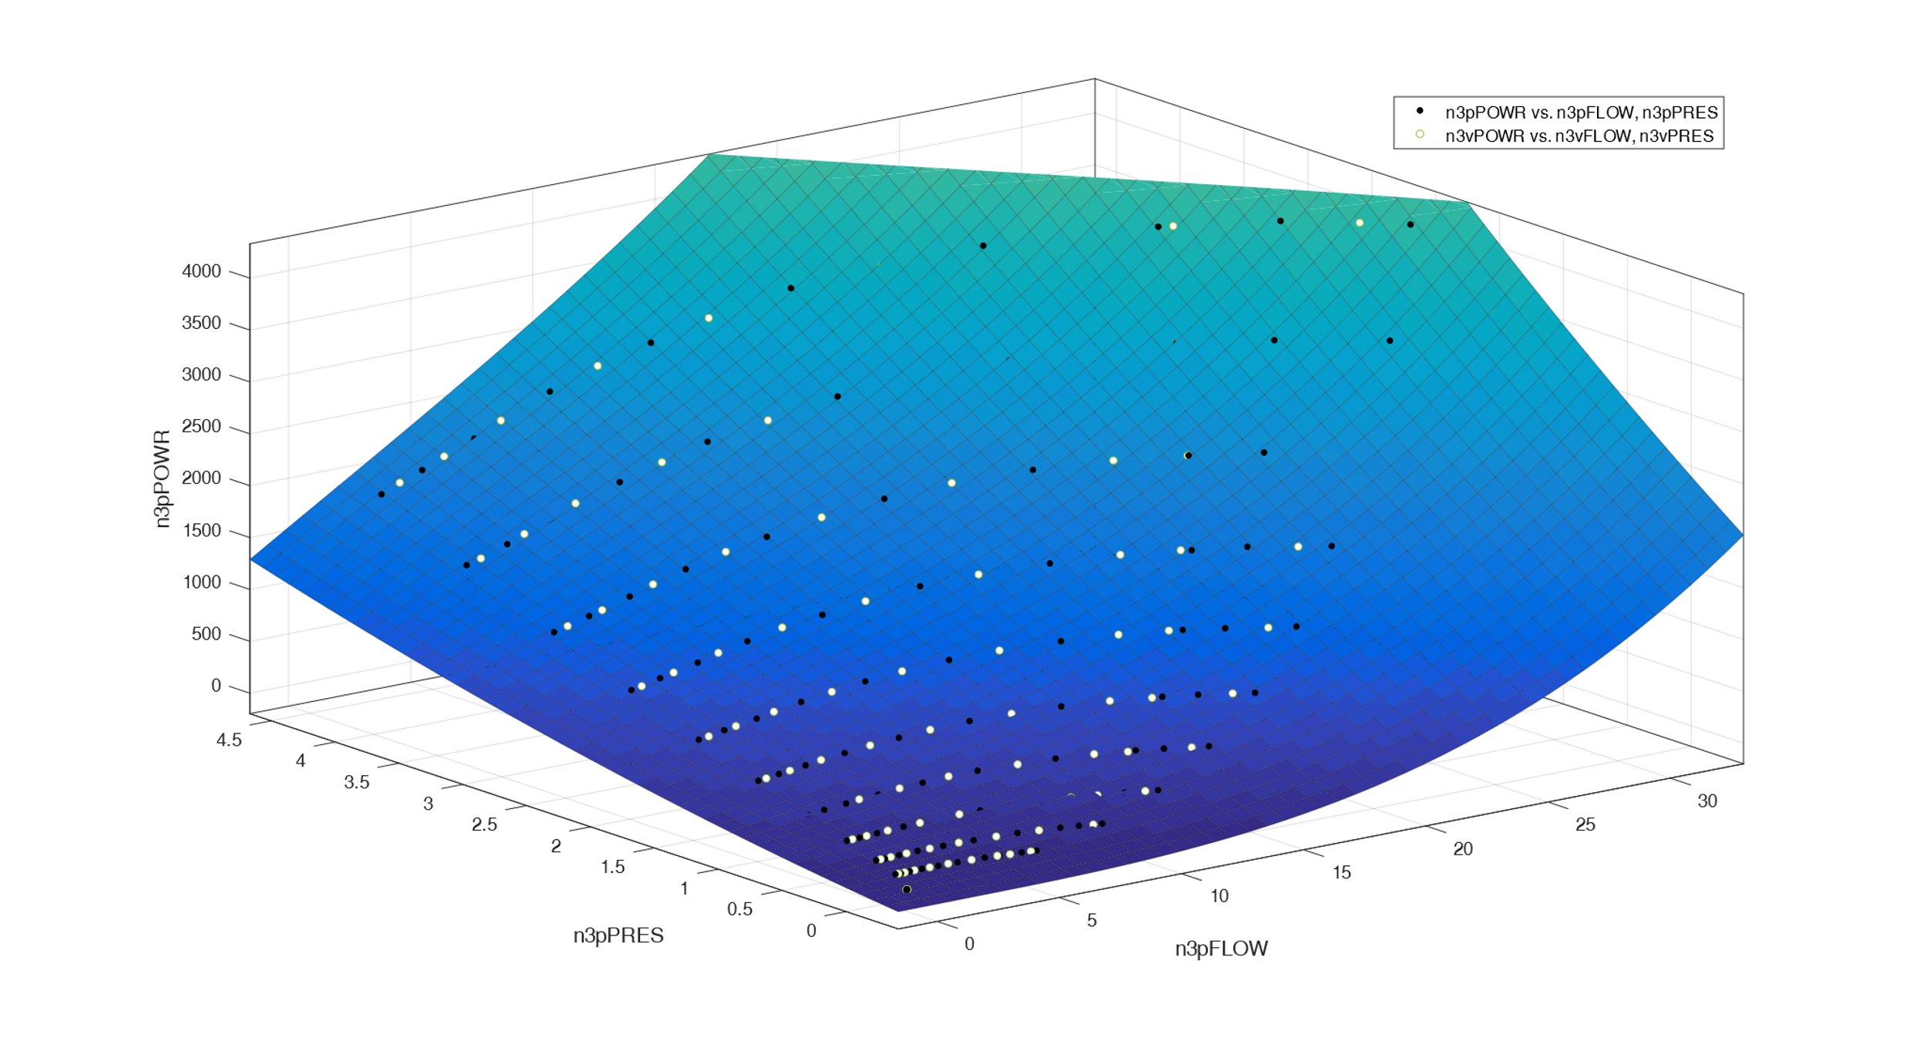
Model Validation
Validation for three-pump-model with validation data in white

Slide 12
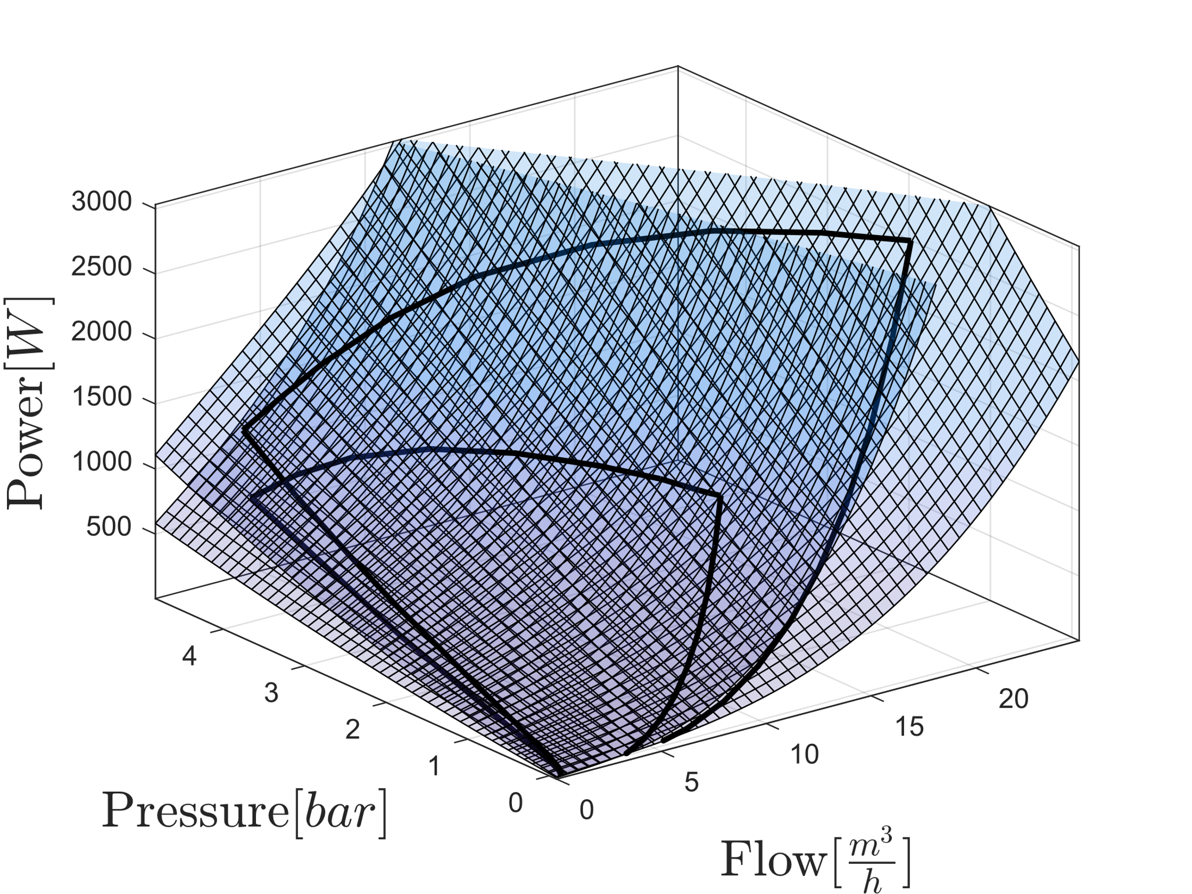
Model Combination
Combined Models for one and two pumps

Slide 13
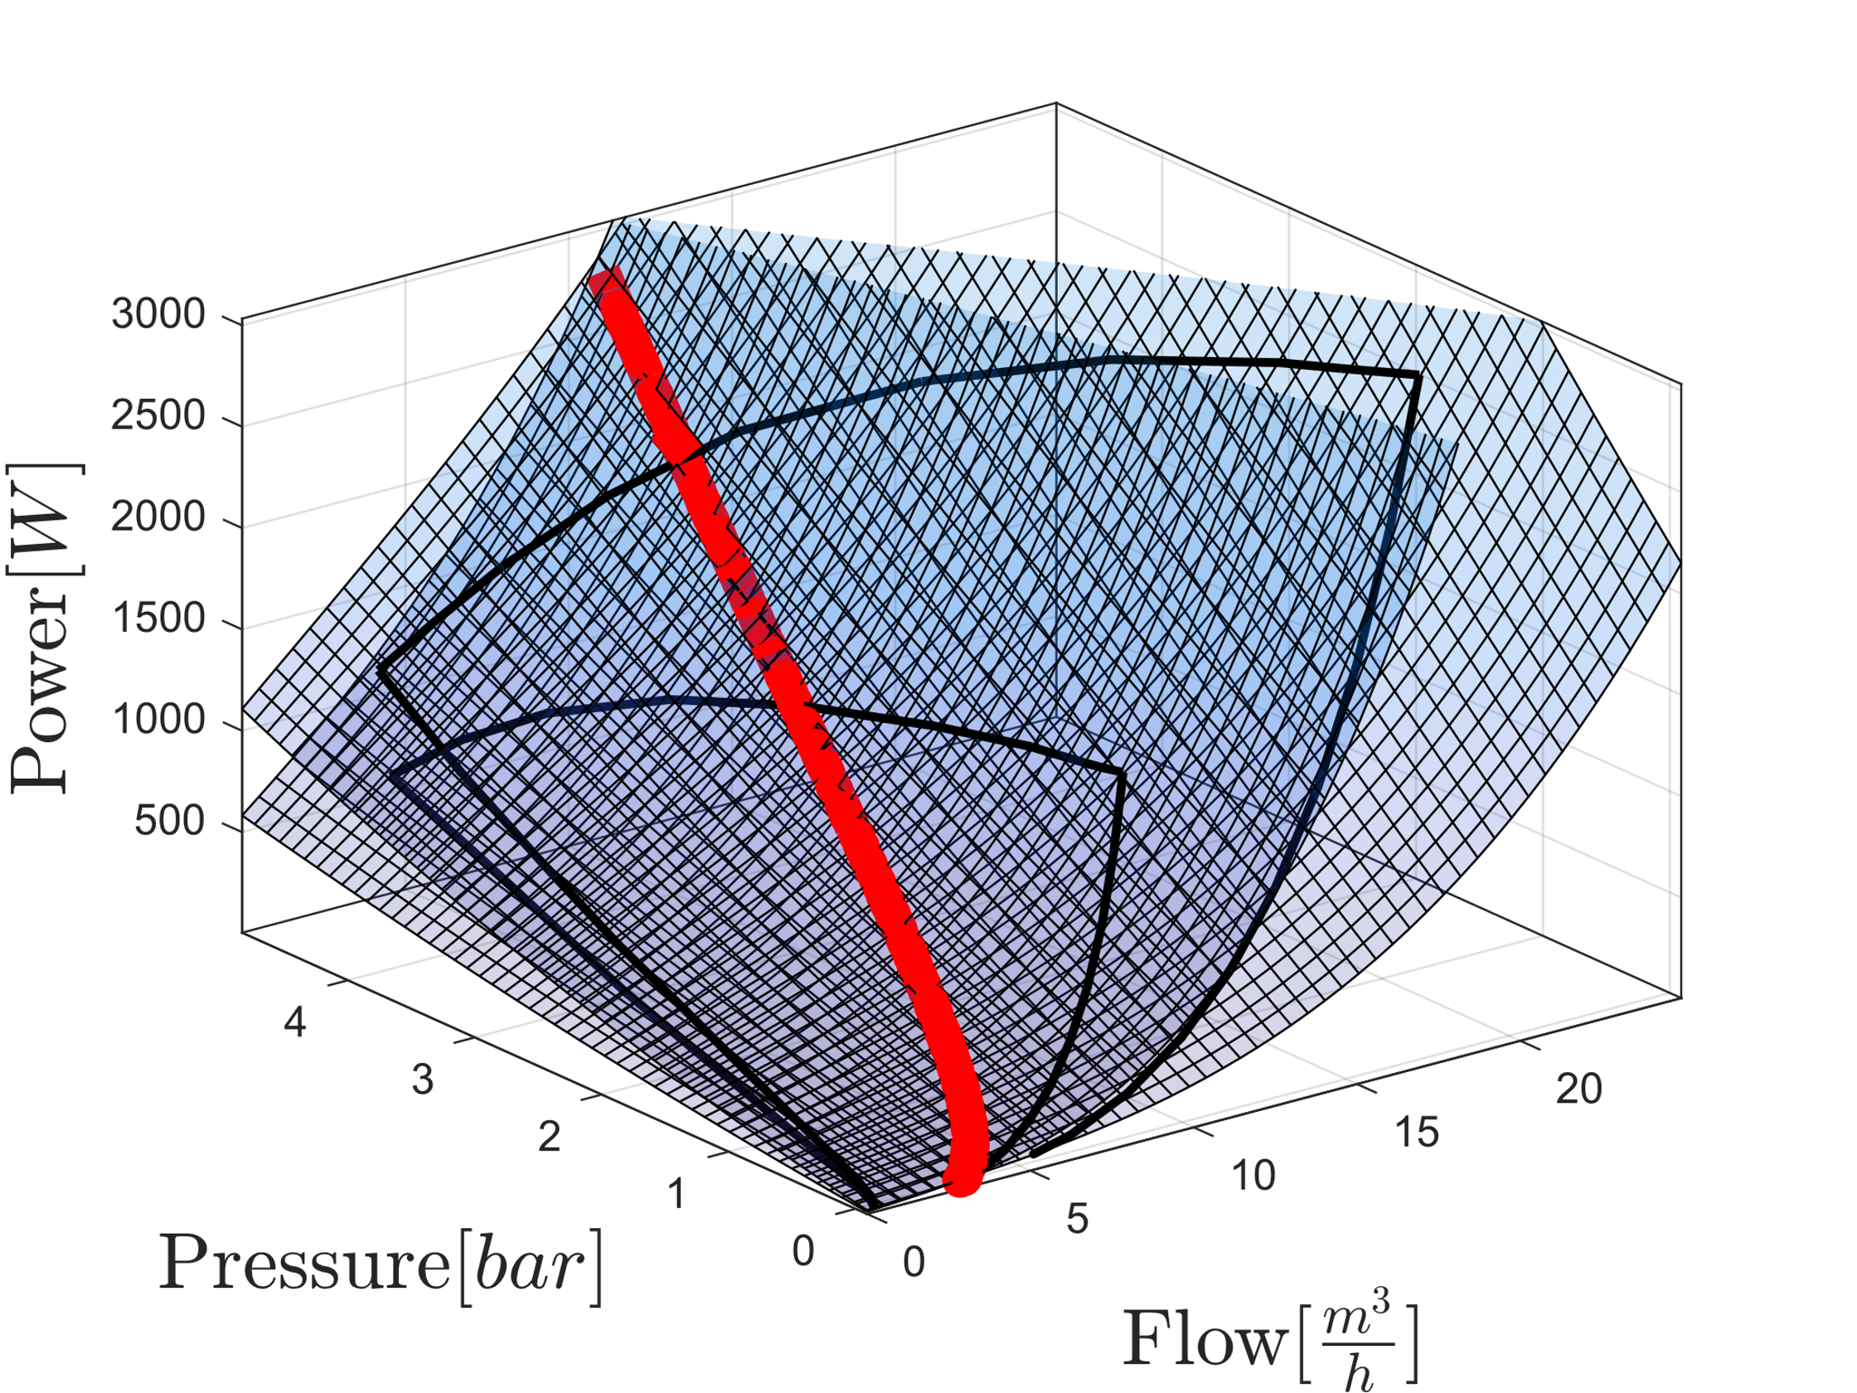
Model Combination
Combined Models for one and two pumps with intersection highlighted

Slide 14
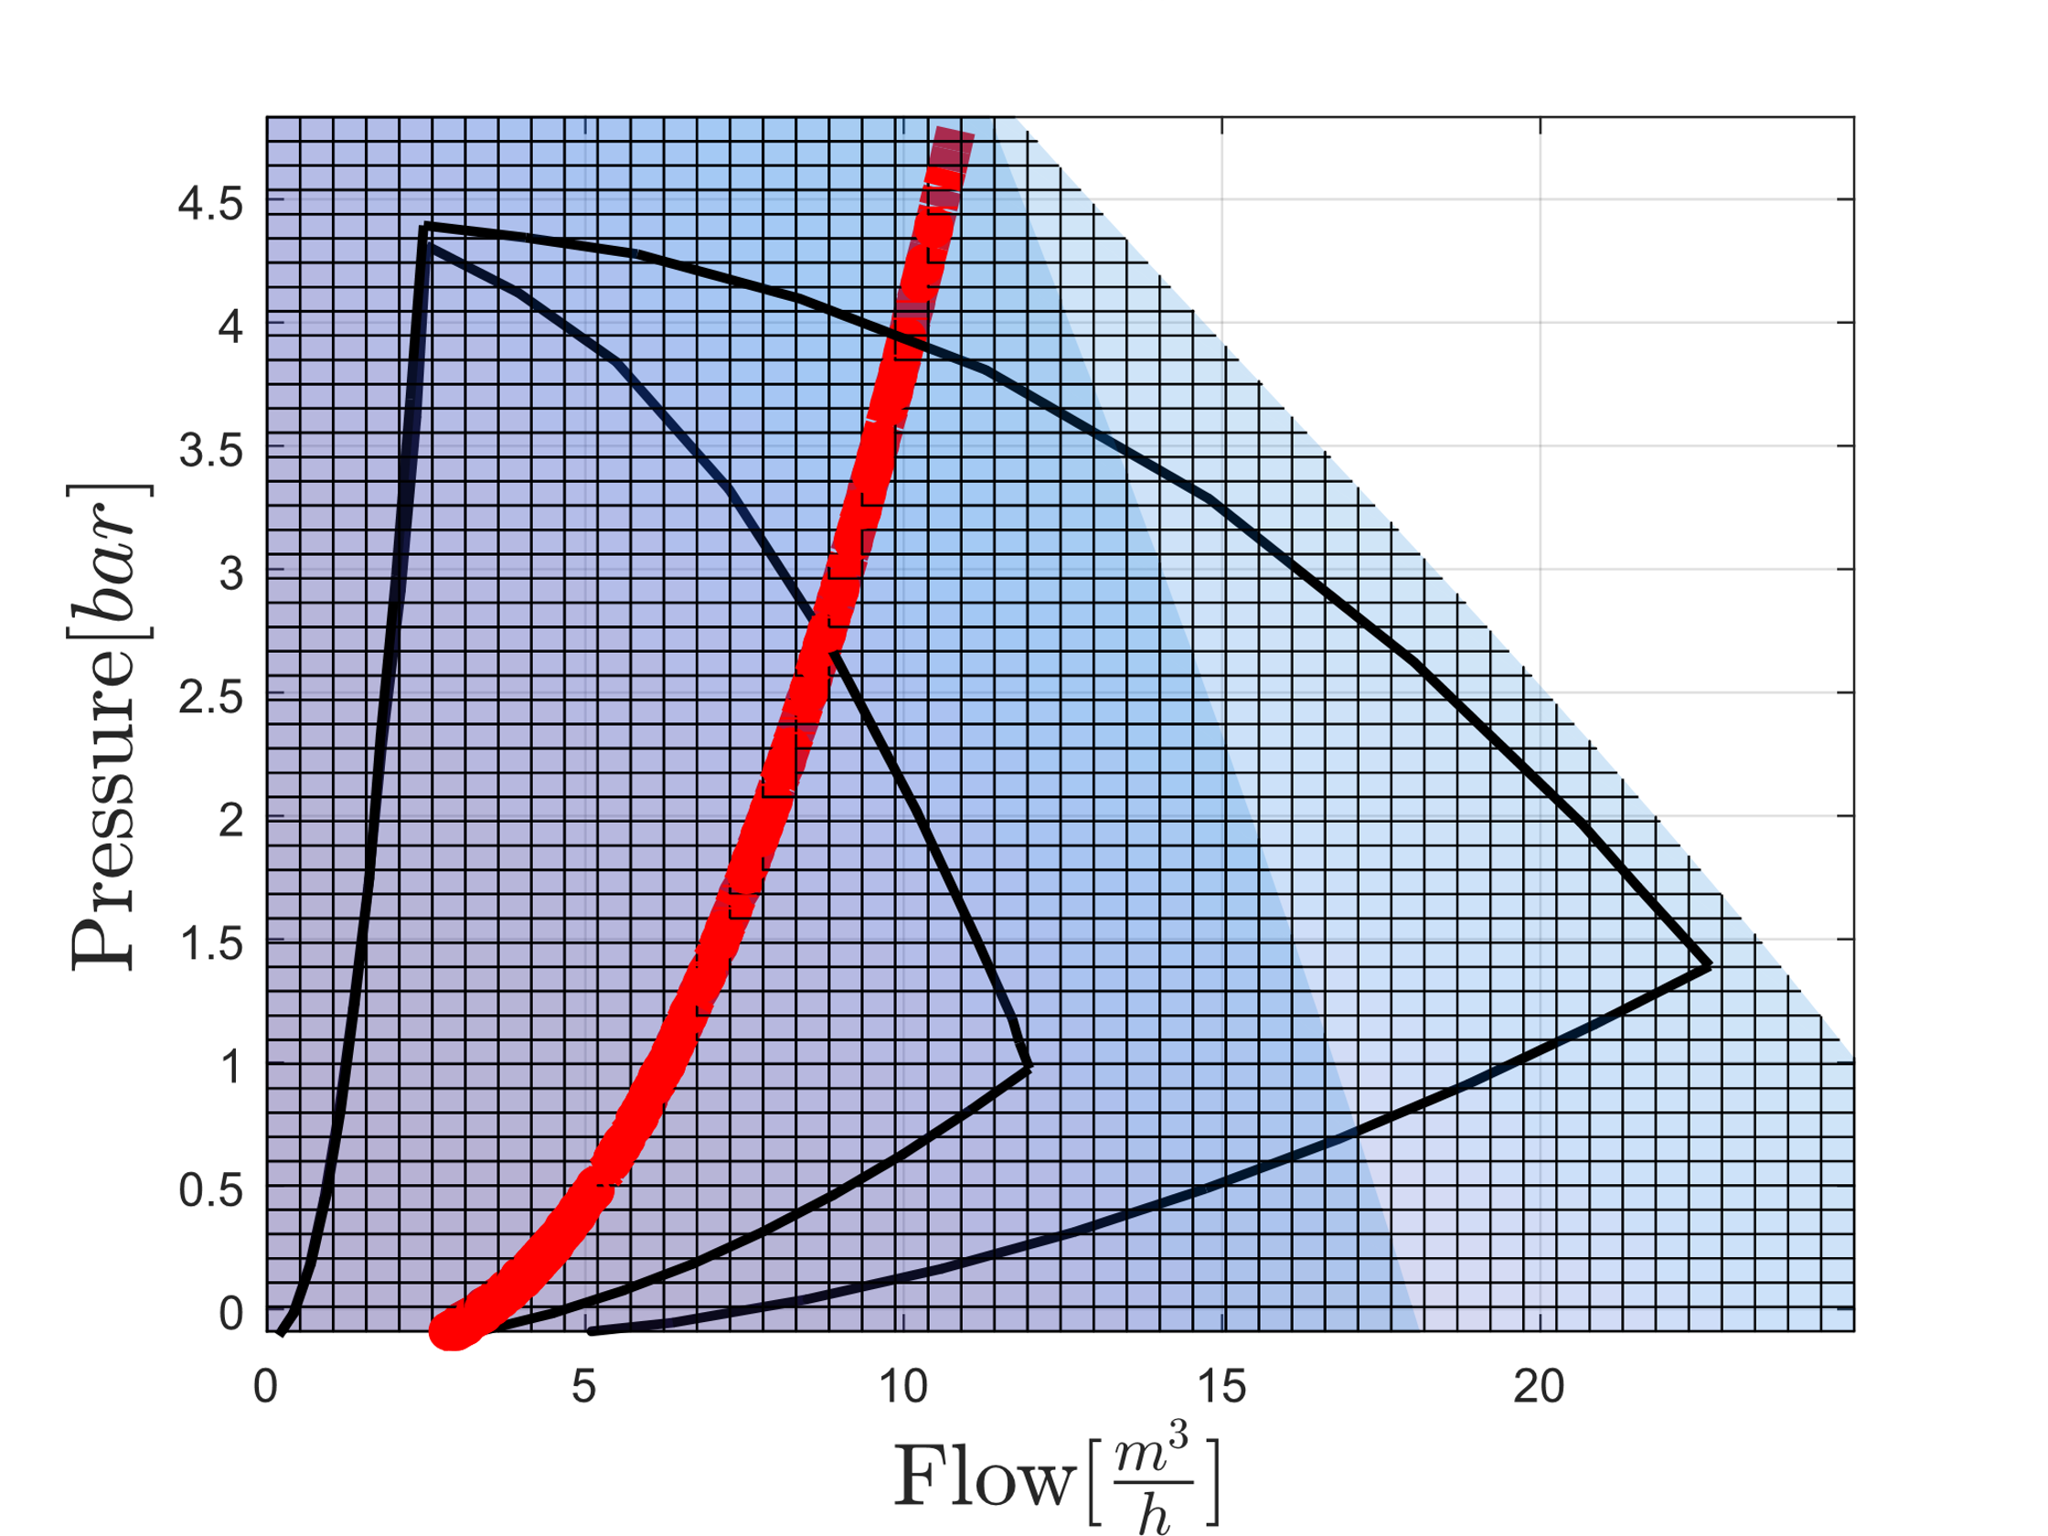
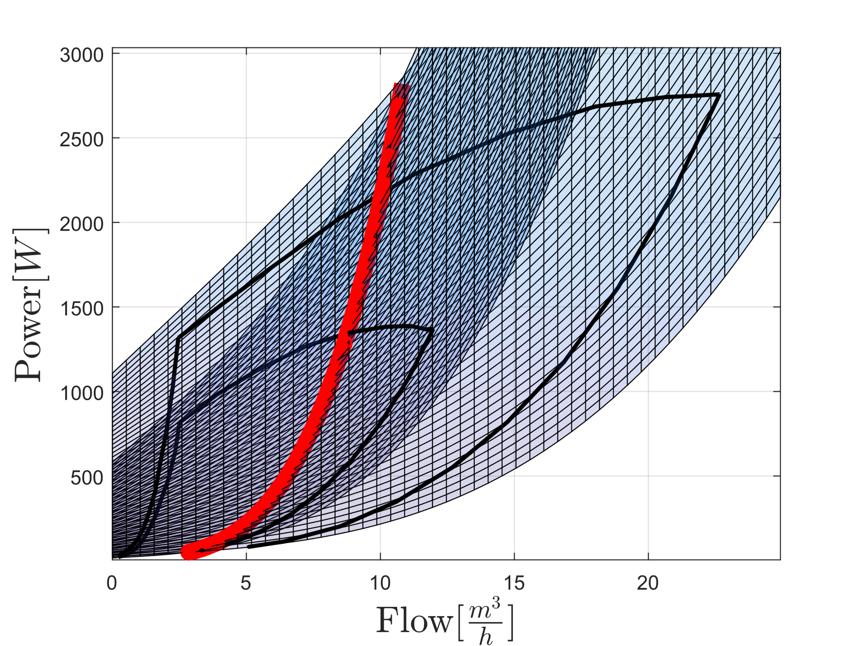
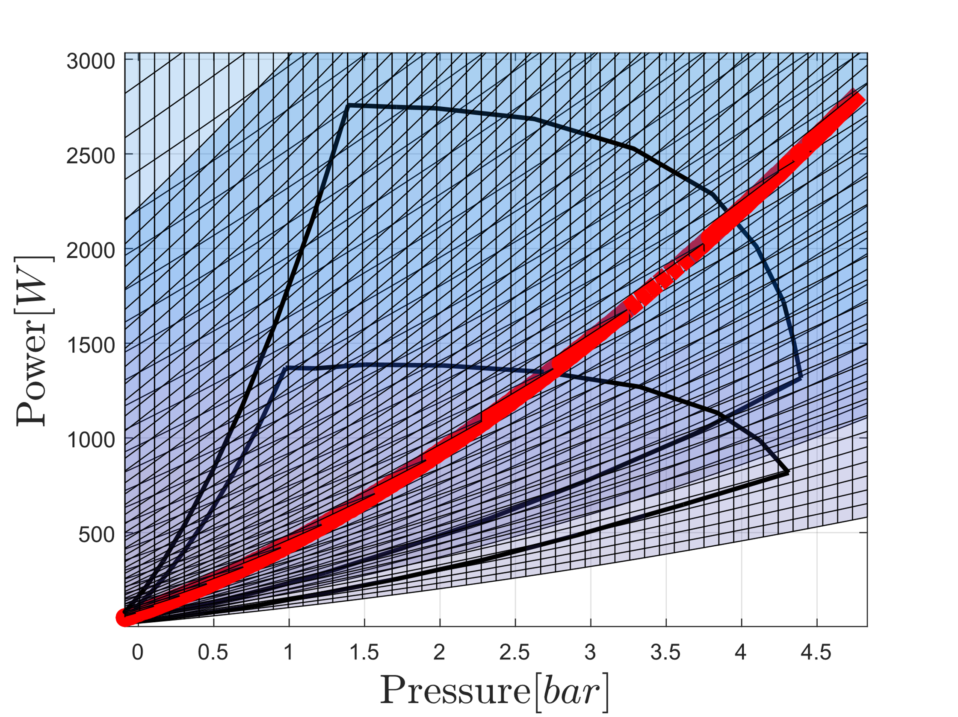

Slide 15
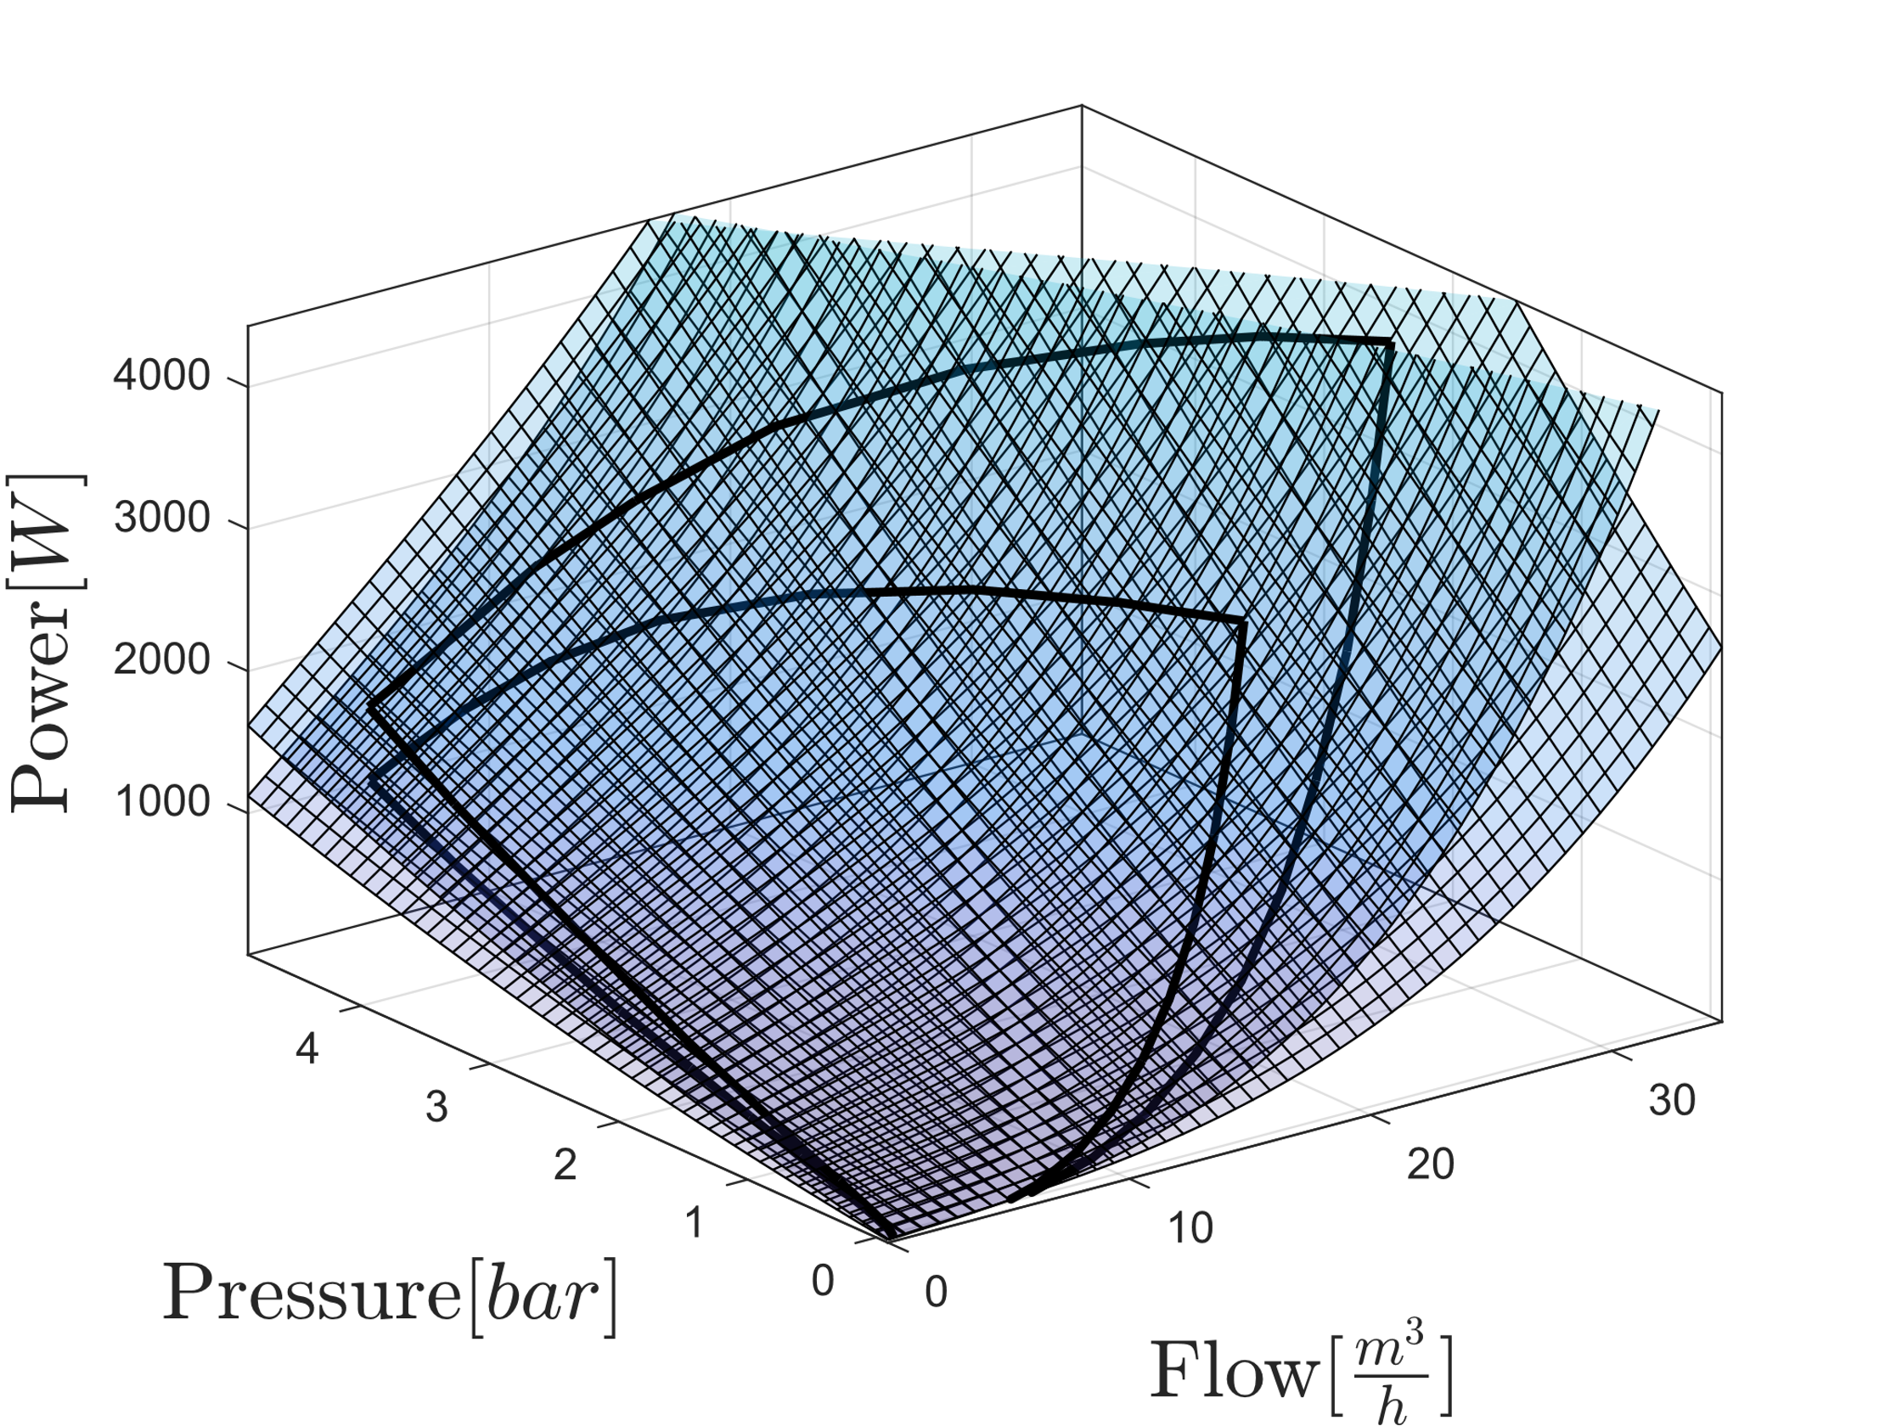
Model Combination
Combined Models for two and three pumps

Slide 16
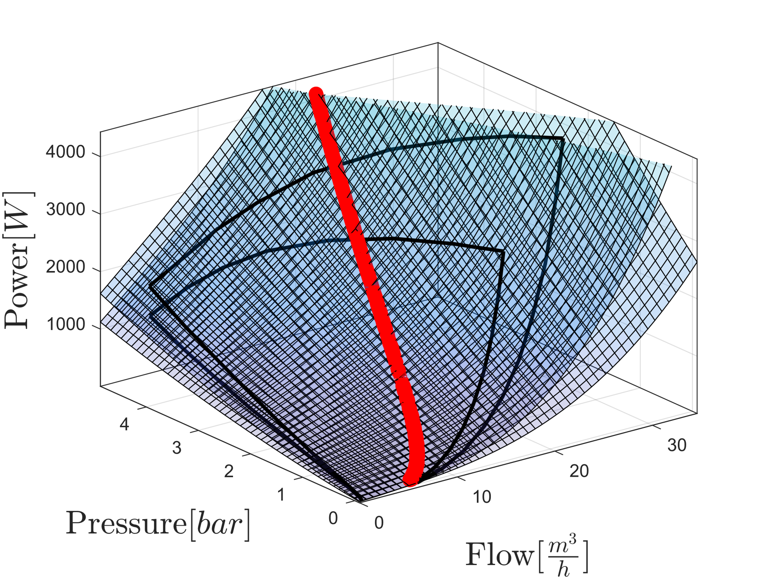
Model Combination
Combined Models for two and three pumps with intersection highlighted

Slide 17
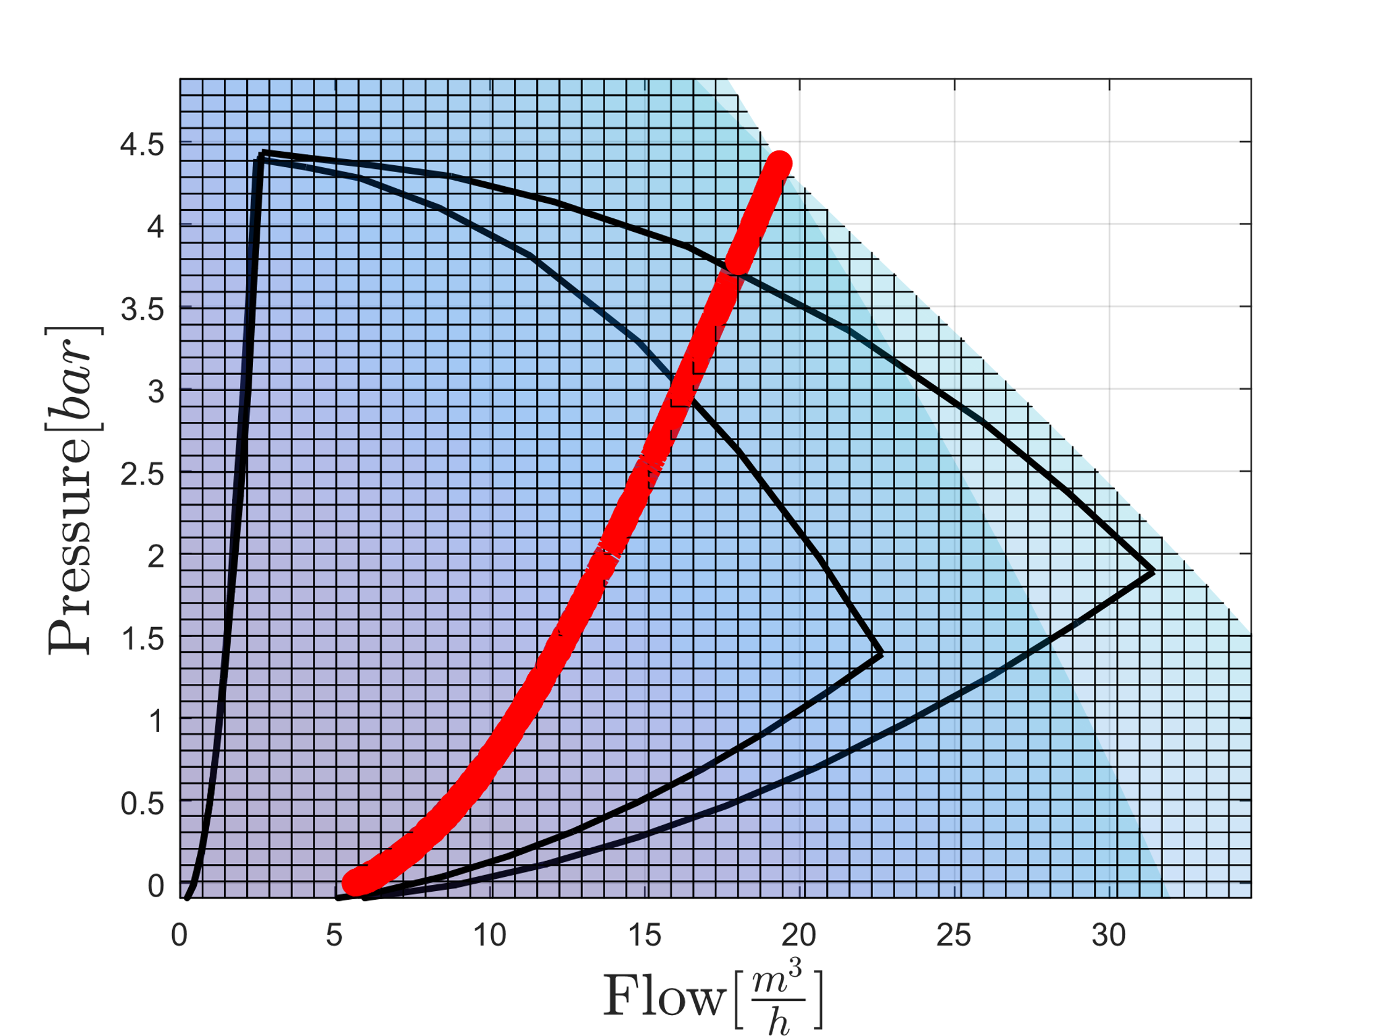
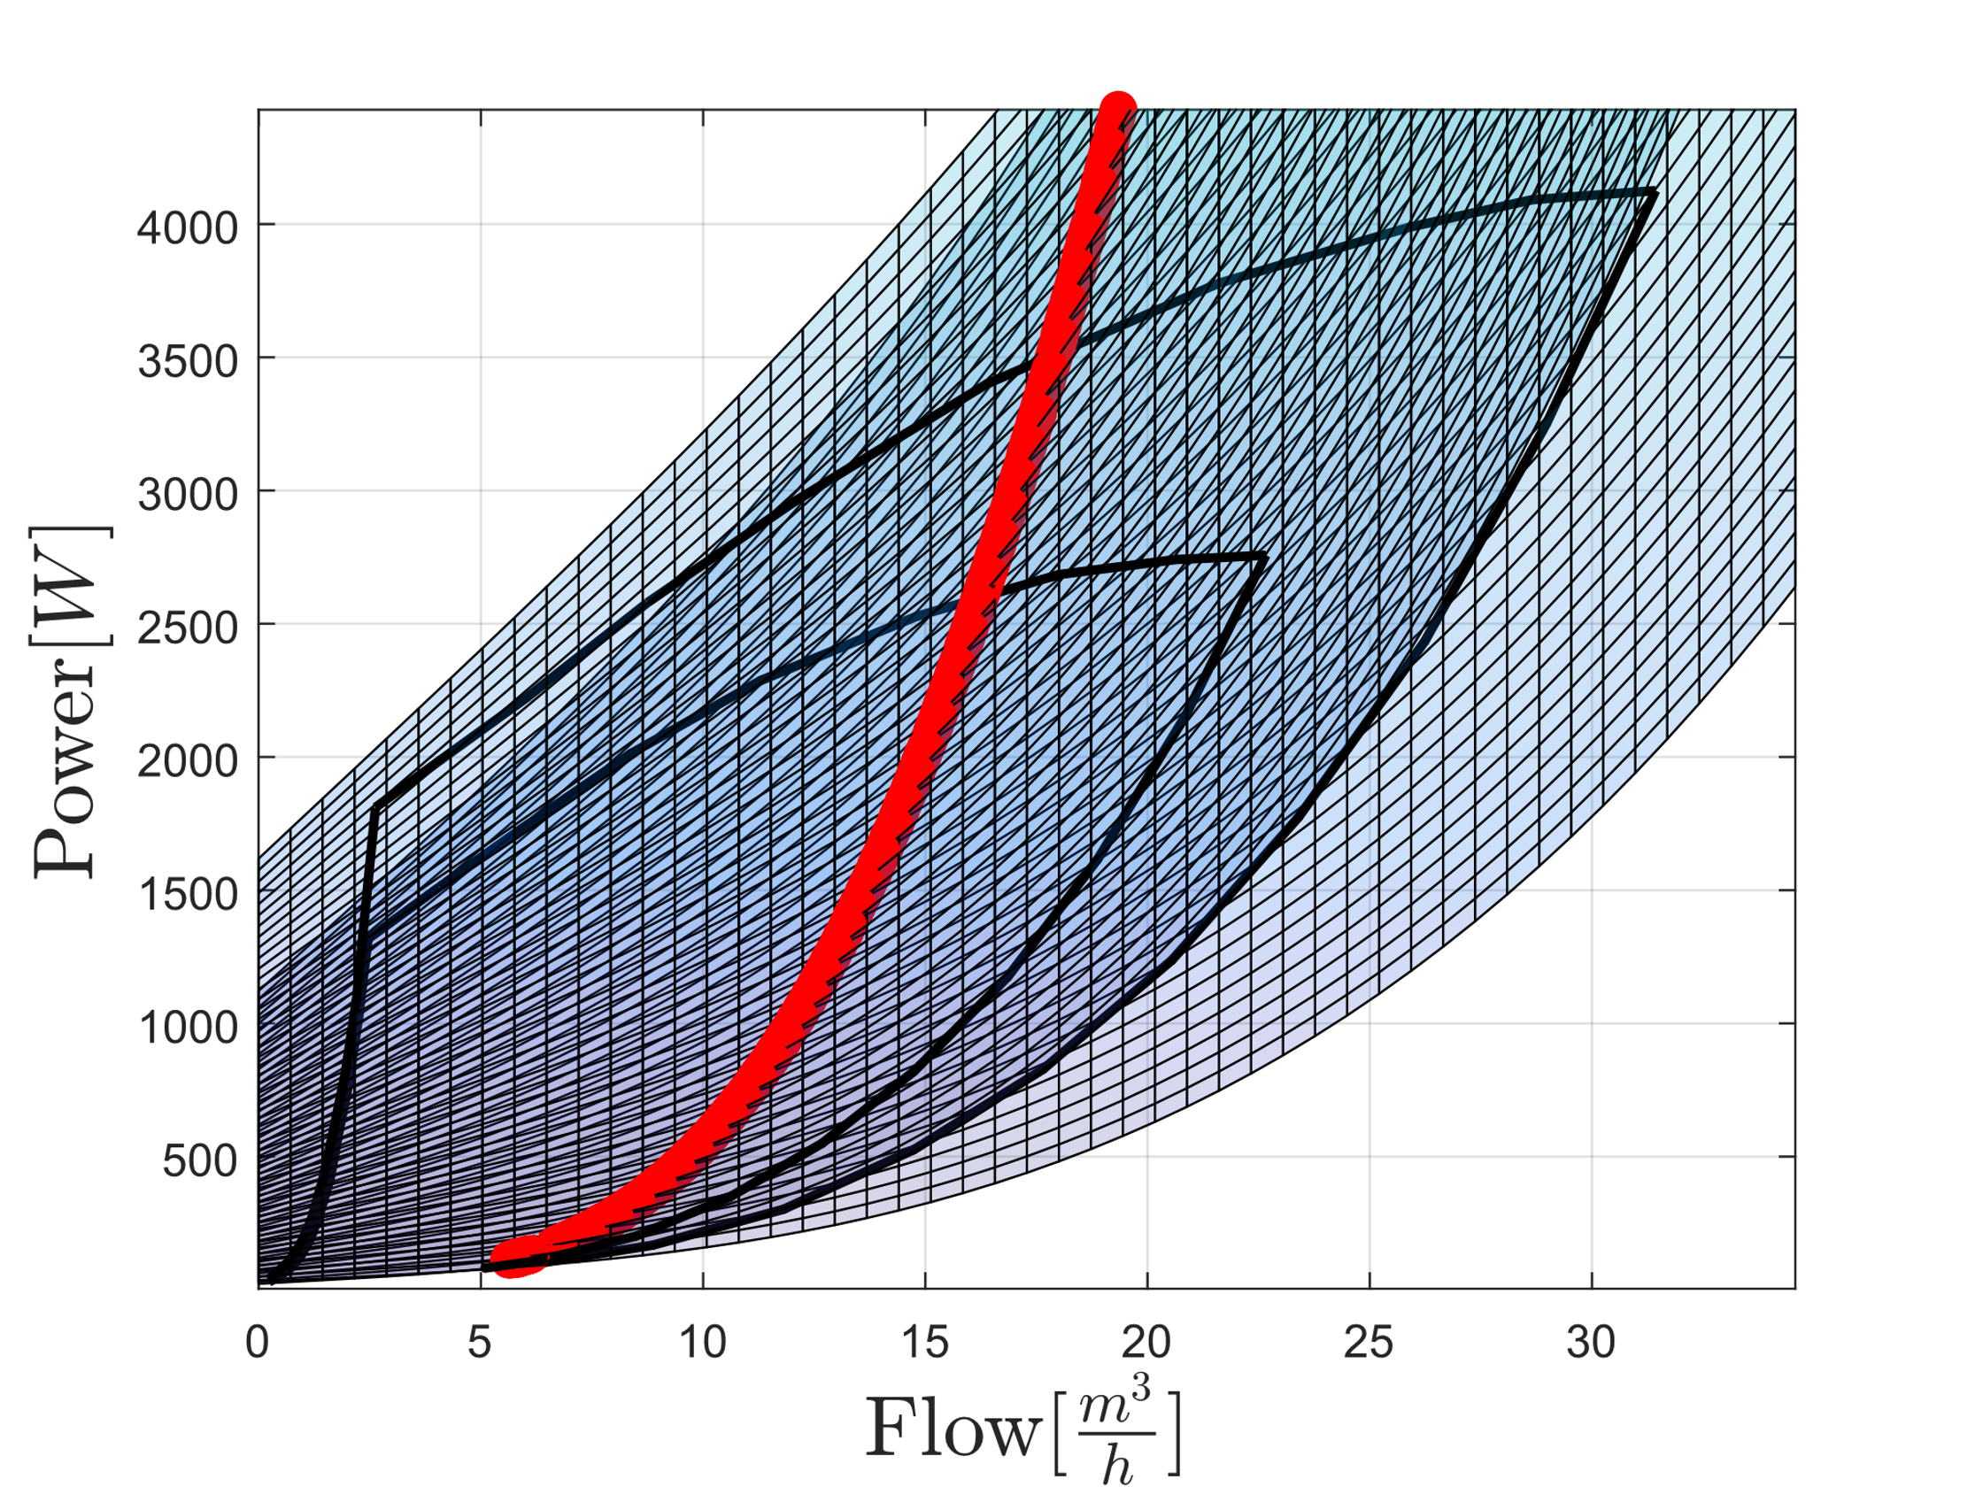
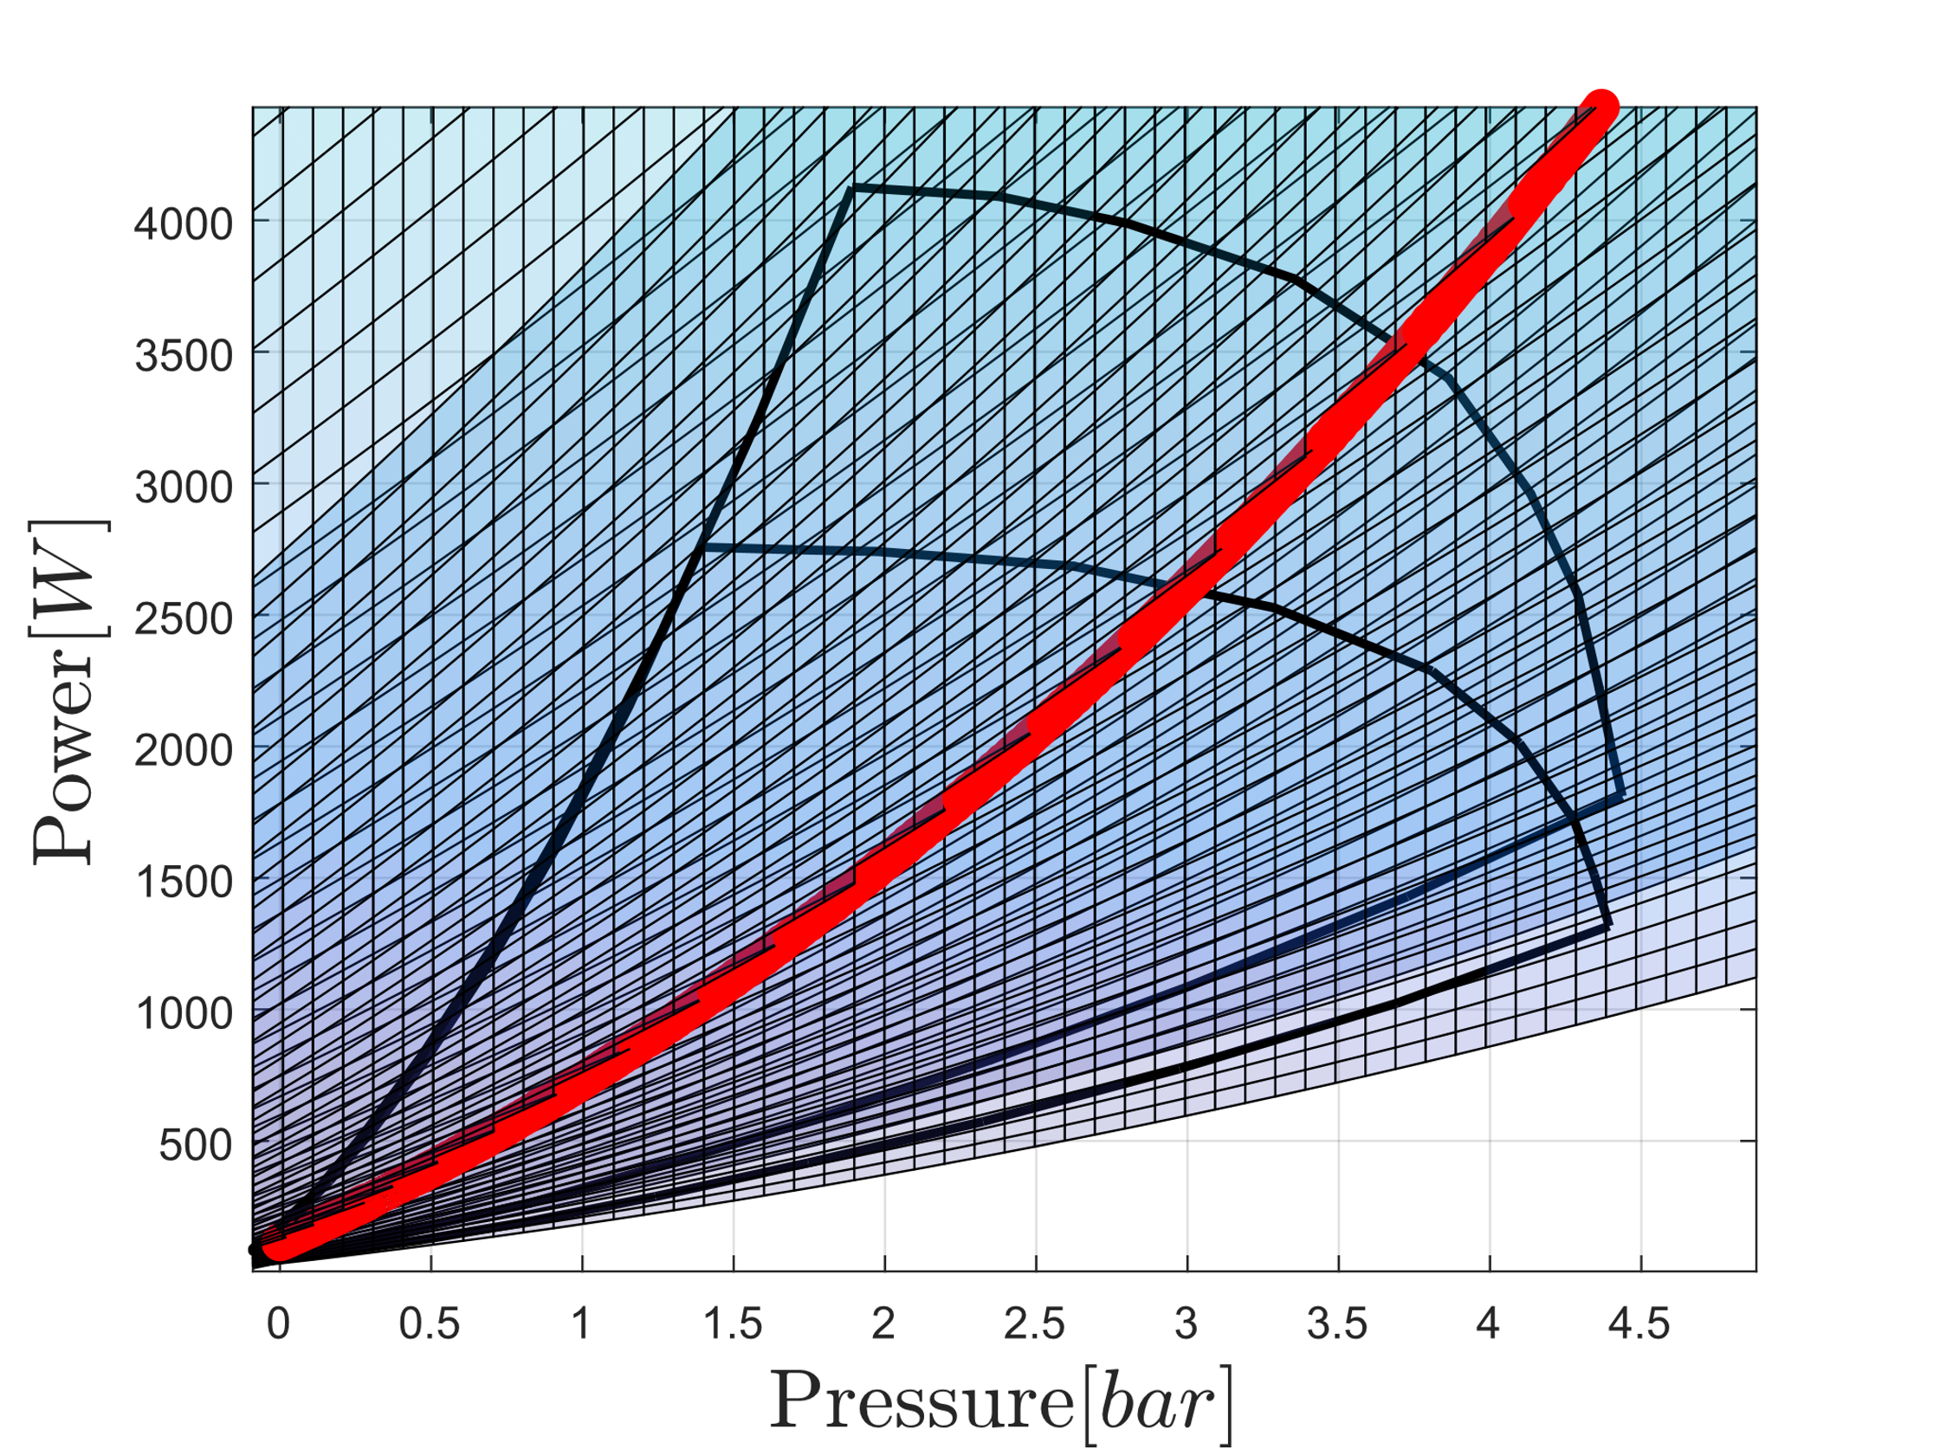

Slide 18
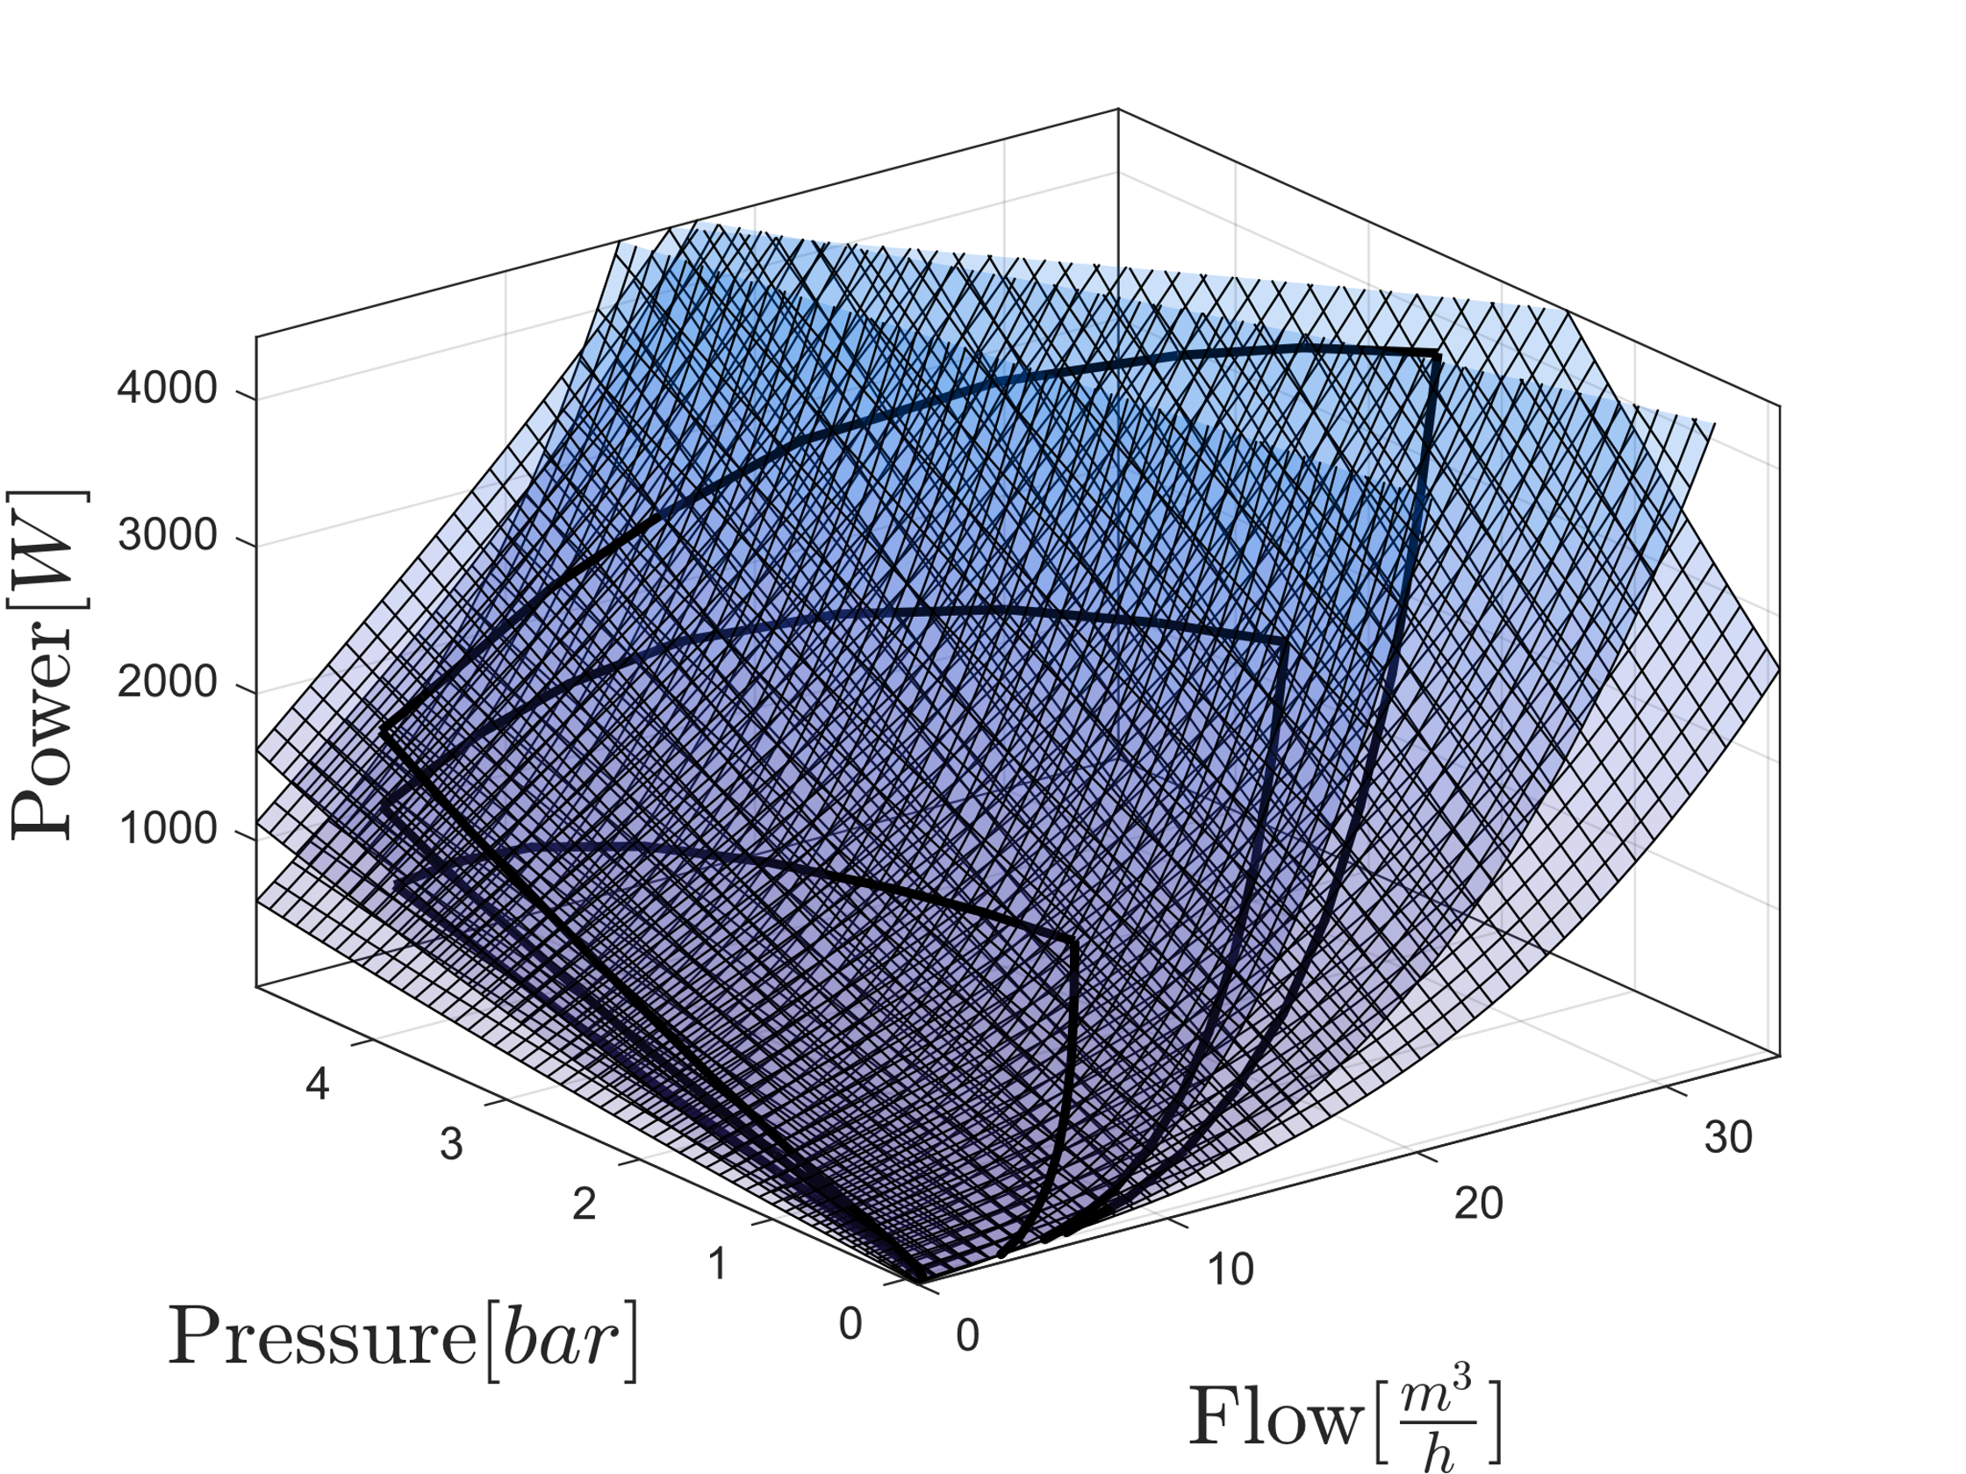
Model Combination
Combined Models

Slide 19
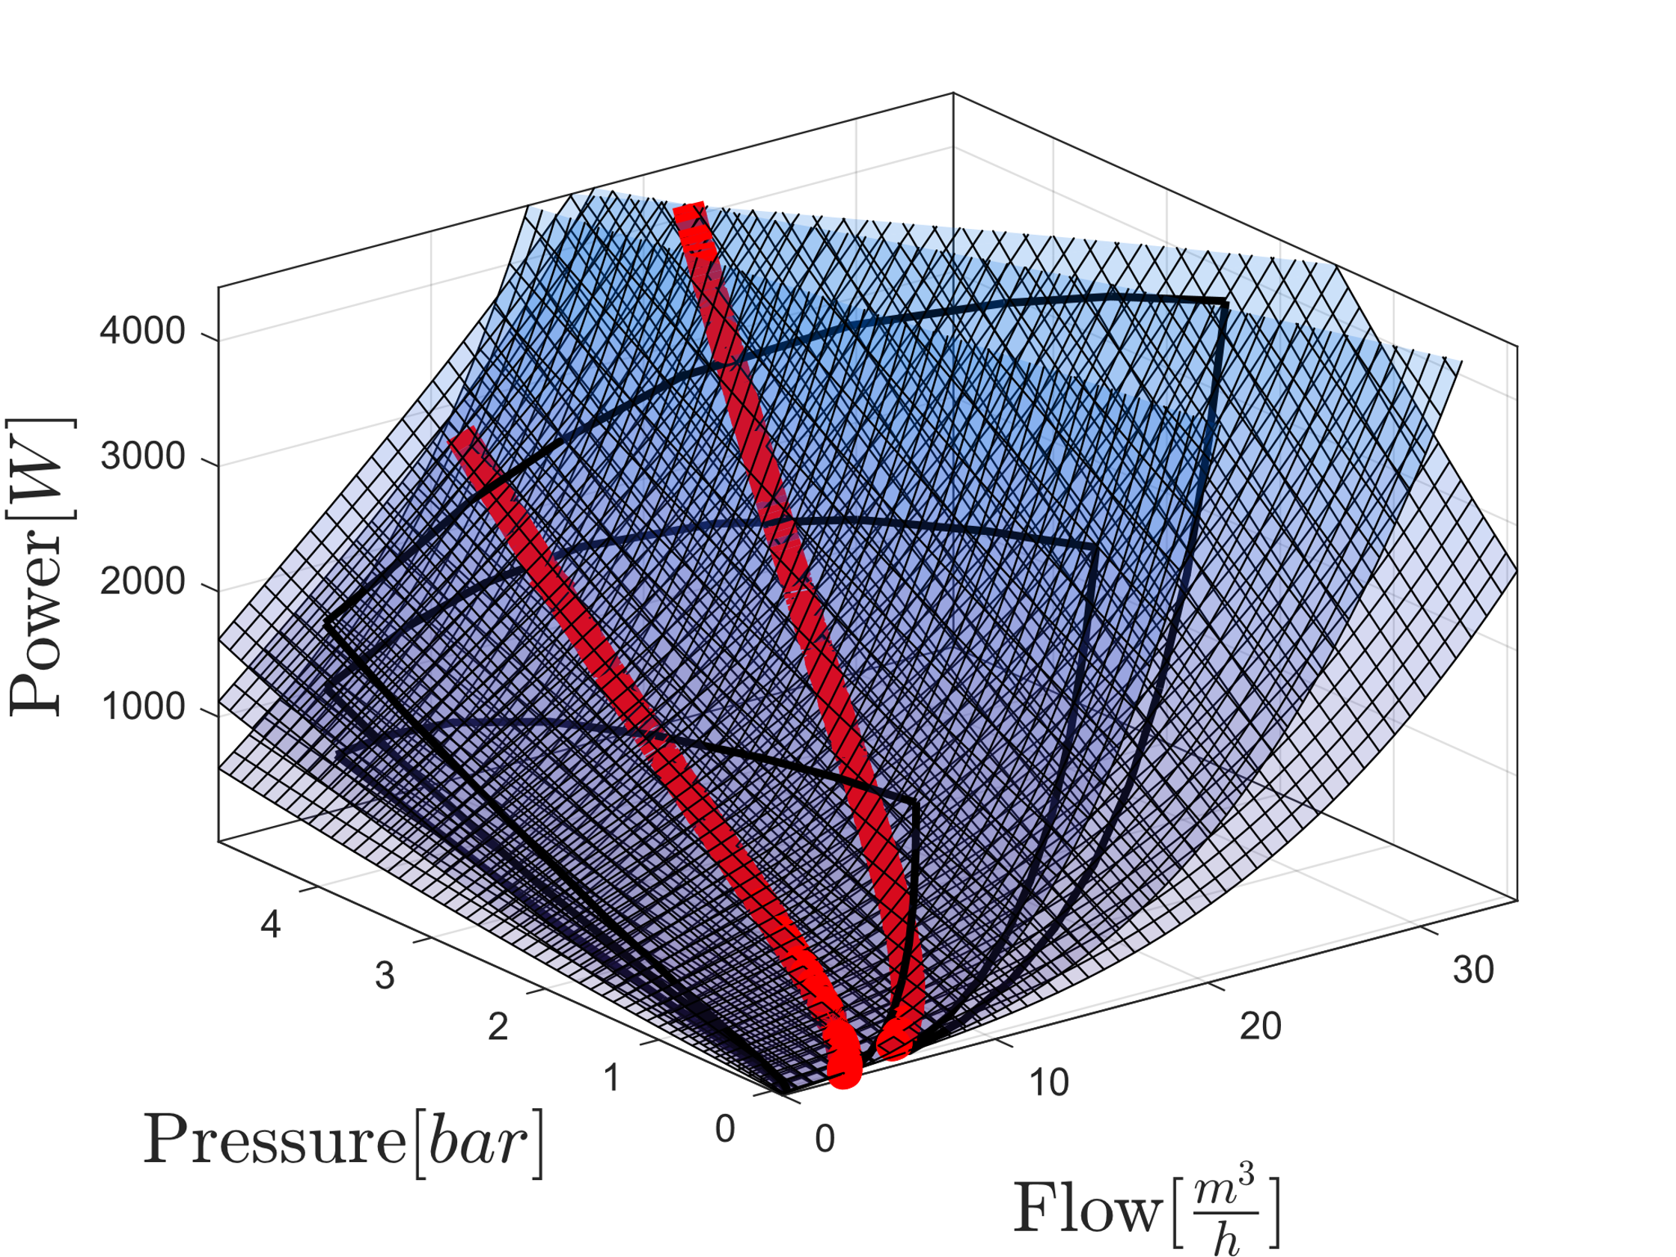
Model Combination
Combined Models with intersection highlighted

Slide 20
